Slide 1
SQL-REINFORCEMENT PROJECT
PRABIN P
Data Analysis & Data Science

Slide 2
OBJECTIVE
This project leverages a simplified version of the IMDB database to uncover insights about movies, their genres, key personnel and audience reception through ratings. The dataset consists of multiple interrelated tables, including:
Movie: Basic details—title, release year, duration, country, income, languages, and production companies.
Genre: Information on movie genres.
Director Mapping: Connections between movies and their directors.
Role Mapping: Links between actors/actresses and movies,directors.
Names: Personal information about film professionals, such as birthdates, heights, and known movies.
Ratings: Movie ratings including average rating, total votes,median rating.
This structured dataset provides a foundation for performing exploratory data analysis, testing advanced SQL query techniques, and ultimately presenting meaningful insights

Slide 3
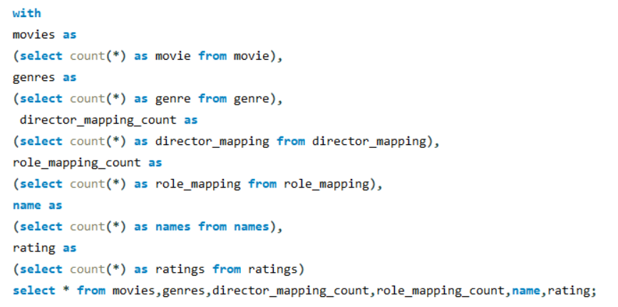

QUERIES
1. Count the total number of records in each table of the database.
Output :

Slide 4
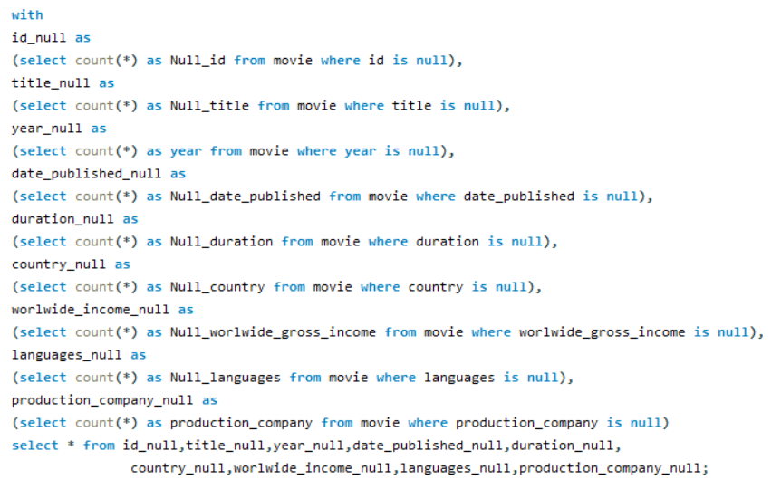
2. Identify which columns in the movie table contain null values.
Output :

Slide 5
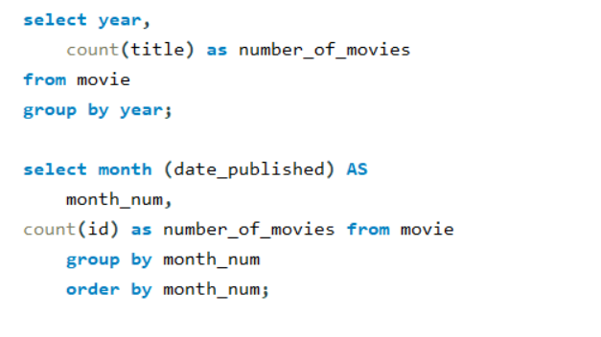
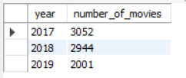
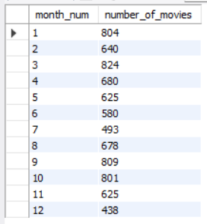
3. Determine the total number of movies released each year, and analyze how the trend changes month-wise.
Output :

Slide 6
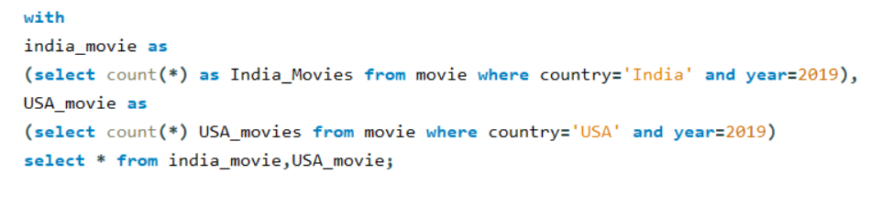

4. How many movies were produced in either the USA or India in the year 2019?
Output :

Slide 7

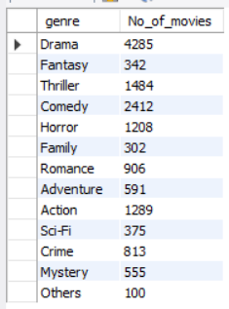
5. List the unique genres in the dataset, and count how many movies belong exclusively to one genre.
Output :

Slide 8
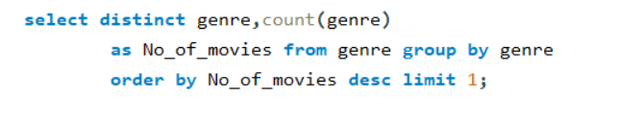


6. Which genre has the highest total number of movies produced?

Slide 9
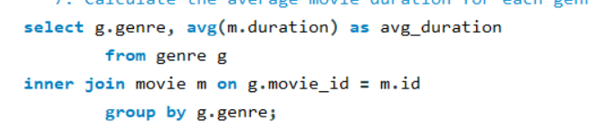
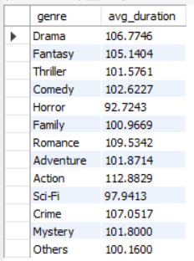
7. Calculate the average movie duration for each genre.

Slide 10
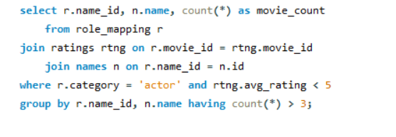
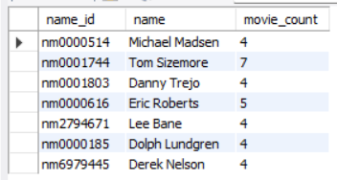
8. Identify actors or actresses who have appeared in more than three movies with an average rating below 5.

Slide 11
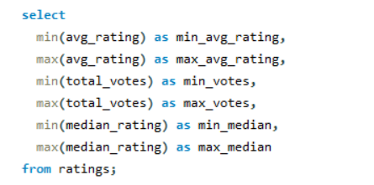
9. Find the minimum and maximum values for each column in the ratings table, excluding the movie_id column.

Slide 12
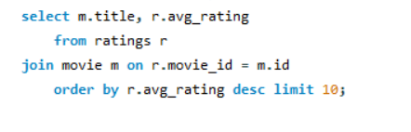
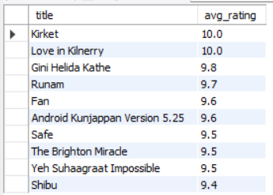
10. Which are the top 10 movies based on their average rating?

Slide 13
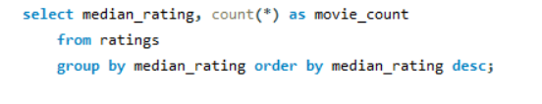
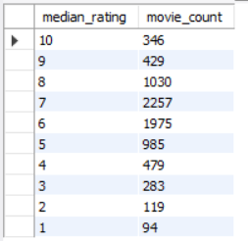
11. Summarize the ratings table by grouping movies based on their median ratings.

Slide 14
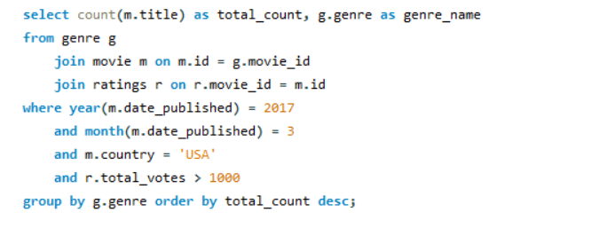
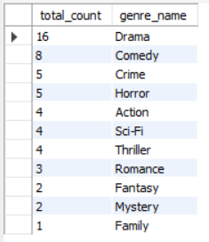
12. How many movies, released in March 2017 in the USA within a specific genre, had more than 1,000 votes?

Slide 15
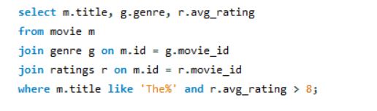
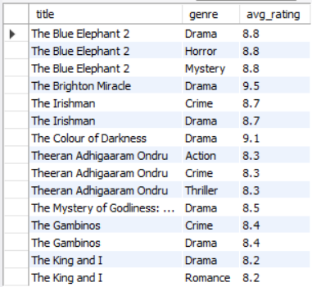
13. Find movies from each genre that begin with the word “The” and have an average rating greater than 8.

Slide 16
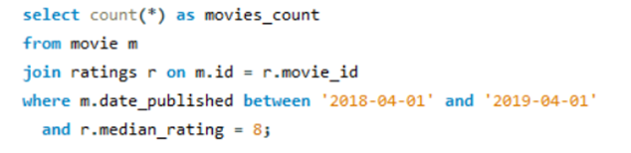

14. Of the movies released between April 1, 2018, and April 1, 2019, how many received a median rating of 8?

Slide 17
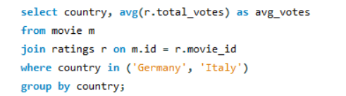

15. Do German movies receive more votes on average than Italian movies?

Slide 18
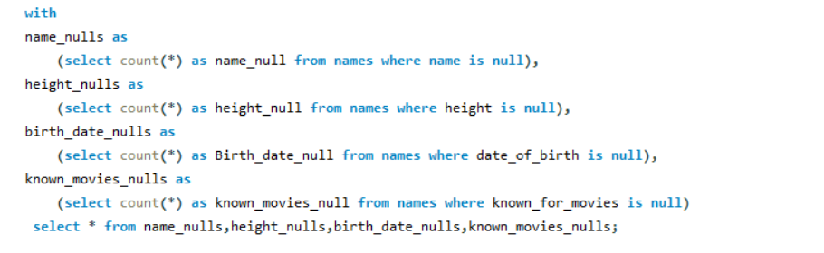

16. Identify the columns in the names table that contain null values.

Slide 19
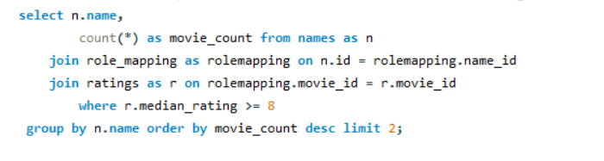

17. Who are the top two actors whose movies have a median rating of 8 or higher?

Slide 20
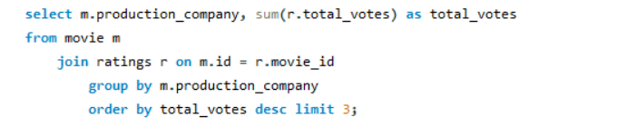
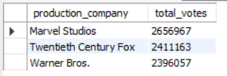
18. Which are the top three production companies based on the total number of votes their movies received?

Slide 21


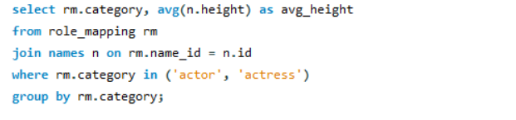

19. How many directors have worked on more than three movies?
20. Calculate the average height of actors and actresses separately.

Slide 22
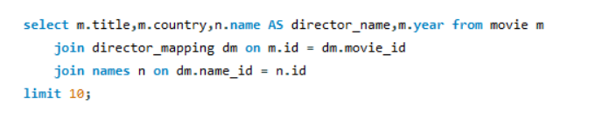
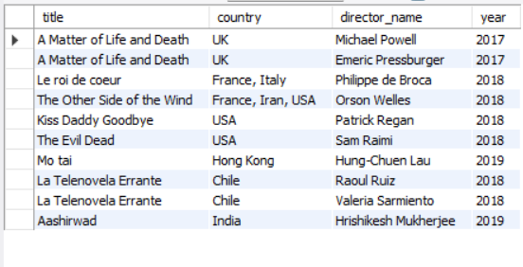
21. List the 10 oldest movies in the dataset along with their title, country, and director.

Slide 23
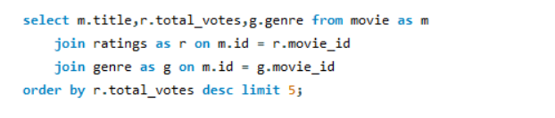
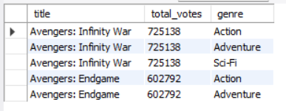
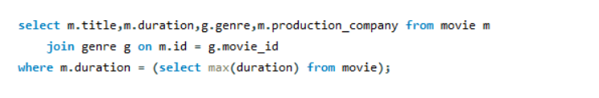

22. List the top 5 movies with the highest total votes, along with their genres.
23. Identify the movie with the longest duration, along with its genre and production company.

Slide 24
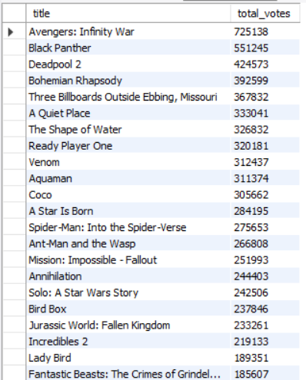
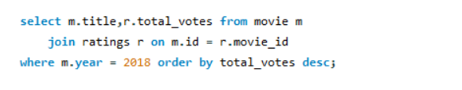
23. Identify the movie with the longest duration, along with its genre and production company.

Slide 25


25. What is the most common language in which movies were produced?

Slide 26
CONCLUSION
After analyzing the IMDB dataset it can derive following insights and recommendations.
Total 1078 movies were produced in the year of 2019 of Drama genre. Therefore, should focus to make Drama genre for their next project to get better outcome.
1059 movies are produced by India and USA; both are most suitable country for making movies.
3289 movies are only one genre out of 8643 movies.
English is the most common language in movie industry.

Slide 27
THANK YOU

